Slide 1

KIT305/721 Mobile Application Development Week 10: Cross-Platform Development and Flutter 101
Dr Lindsay Wells
School of ICT
University of Tasmania

Slide 2

Landscape of Mobile Technologies
Symbian
ReactNative
Blackberry
RIM Widget SDK
iOS (Swift)
Apple Dashcode
Windows Mobile
MeeGo Web Runtime
Android (Java/Kotlin)
MotherApp
WebOS
Appcelerator Titanium
MeeGo
Rhomobile Rhodes
Bada
JIL Widget Engine
LiMo
Cordova / Ionic
BREW
Flutter
Firefox OS
Maemo
Microsoft Silverlight
Google Web Toolkit
Adobe Flash
Curl
Nokia Qt
Xamarin
Oracle JavaFX
HTML5 (Mobile Web)
Google Gears

Slide 3
Landscape of Mobile Technologies
ReactNative
iOS (Swift)
Android (Java/Kotlin)
Cordova / Ionic
Flutter
Xamarin
HTML5 (Mobile Web)

Slide 4
Mobile Application Development Frameworks

Slide 5
Mobile Device Development Landscape
Mobile
Web
HTML5 (+CSS, JS)
Web-based Cross-Platform Toolkits
Cordova (+HTML, CSS, JS)
Native Mobile Apps
Android, iOS, Windows Mobile (Java/Swift)
Cross-compiler Tools
Xamarin (C#)
Flutter (Dart)
Unity (C#)
Native Mobile Apps
Android, iOS, Windows Mobile (Java/Swift)
Notes:
“

Slide 6
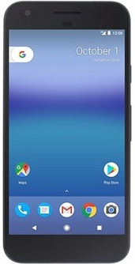
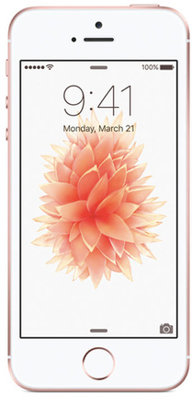
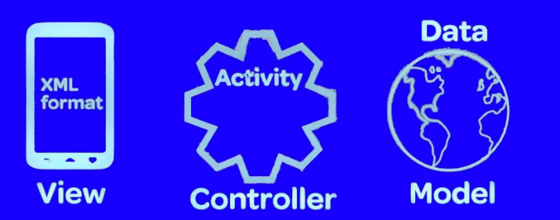
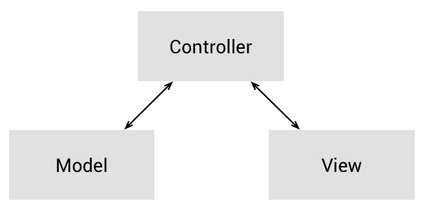
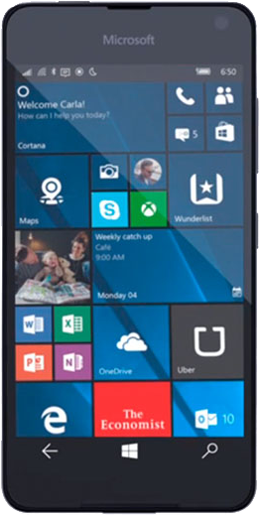
Native Device Development Tools
 | Android | iOS | Windows Mobile
IDE | Android Studio | XCode | Visual Studio
Programming Language | Java | Objective-C, Swift | .Net/C#
Software Design Paradigms
6

Slide 7
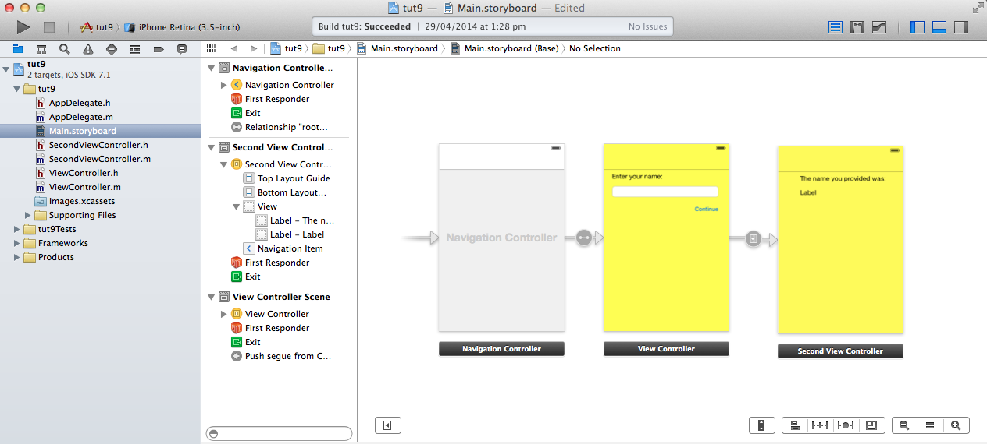
iOS – XCode Development
Notes:
Lindsay is deliberately not updating these slides, so we can see what super old xcode used to look like

Slide 8
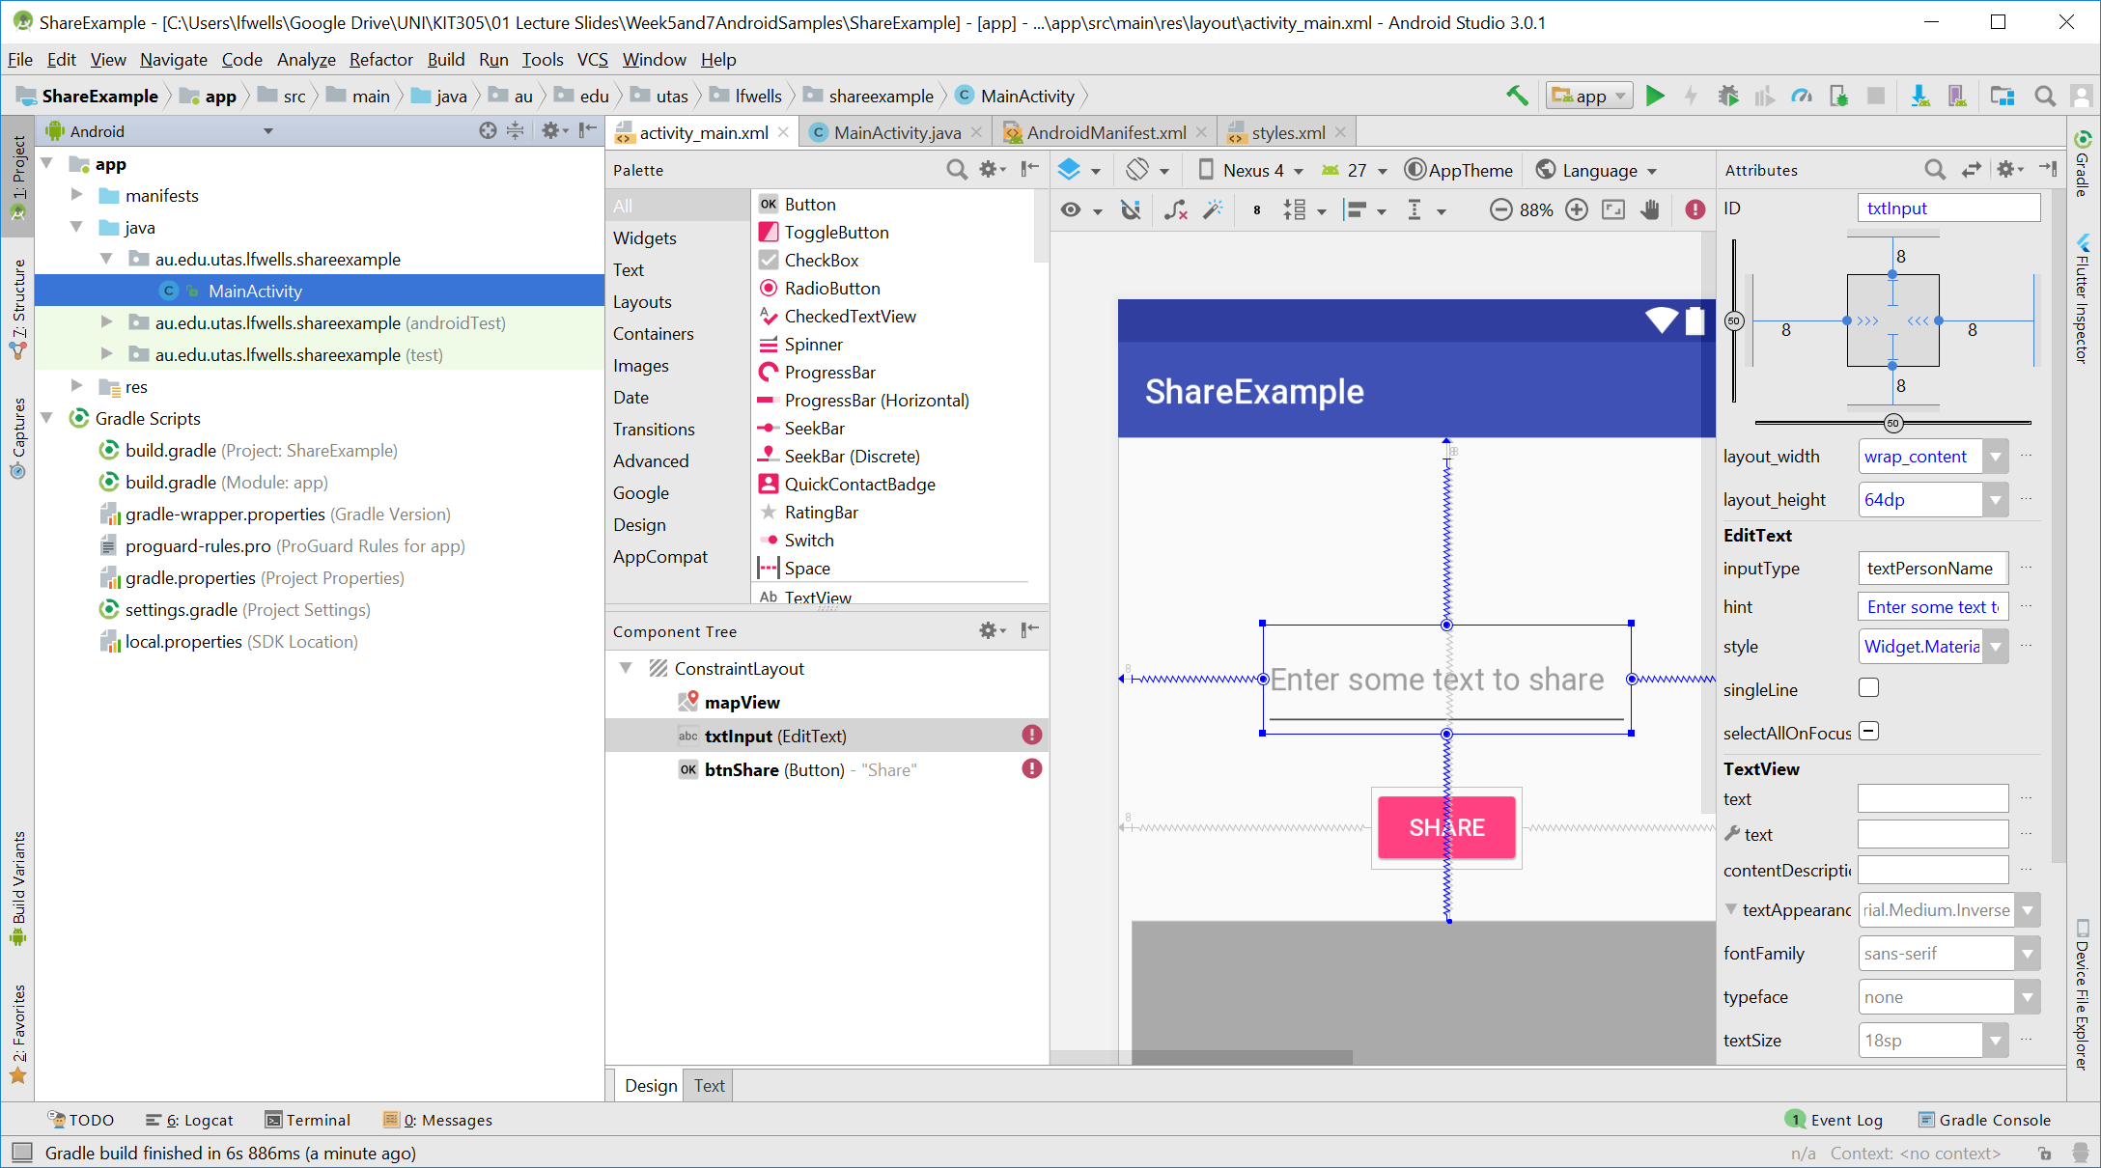
Android – Android Studio Development

Slide 9
Mobile Device Development Landscape
Mobile
Web
HTML5 (+CSS, JS)
Web-based Cross-Platform Toolkits
Cordova (+HTML, CSS, JS)
Cross-compiler Tools
Xamarin (C#)
Flutter (Dart)
Unity (C#)
Native Mobile Apps
Android, iOS, Windows Mobile (Java/Swift)
Cross-compiler Tools
Xamarin (C#)
Flutter (Dart)
Unity (C#)
(next week)
Notes:
“

Slide 10
Cross-Compiler Tools
Write one set of code, can target multiple platforms
Compiles to the each platform
Produces native code
Better performance
Native UI elements
Consistent user experience to other applications on same platform
Upgraded visuals when the OS upgrades
Non-Native (custom) UI elements
Consistent user experience on same application on different platforms
Rendered by the tool itself using low-level graphics APIs
Notes:
Most systems capable of doing native and non-native ui
We can also write non-native custom ui elements directly in Android and iOS programs, but we generally shouldn’t, because we aren’t amazing graphics/OS programmers
Native vs Non-native refers back to discussions in class about conventions of OS and should we adopt them or not

Slide 11

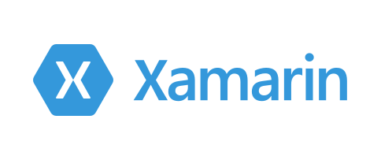




Cross-Compiler Tools
Xamarin
Uses C# (create in Visual Studio)
1.4 million developers using it as of 2017
Creates “native” UI elements
Qt
Uses C++
Used by Adobe, Valve, Skype, VLC, Autodesk
Not just mobile applications
Flutter
Uses Dart (create in Android Studio)
Made by Google (2017)
Renders “native looking” UI elements
Unity
Uses C# (Visual Studio + dedicated editor application)
ReactNative (created by Facebook)
Uses Javascript
Uses same stateful widget-based approach as React and Flutter
Notes:
Maybe you would choose to use one of these based upon your existing skill set
(similarly if your skillset is web, then choose that)
Flutter is interesting that Google decided to make this
Of course many other tools, but these are popular

Slide 12
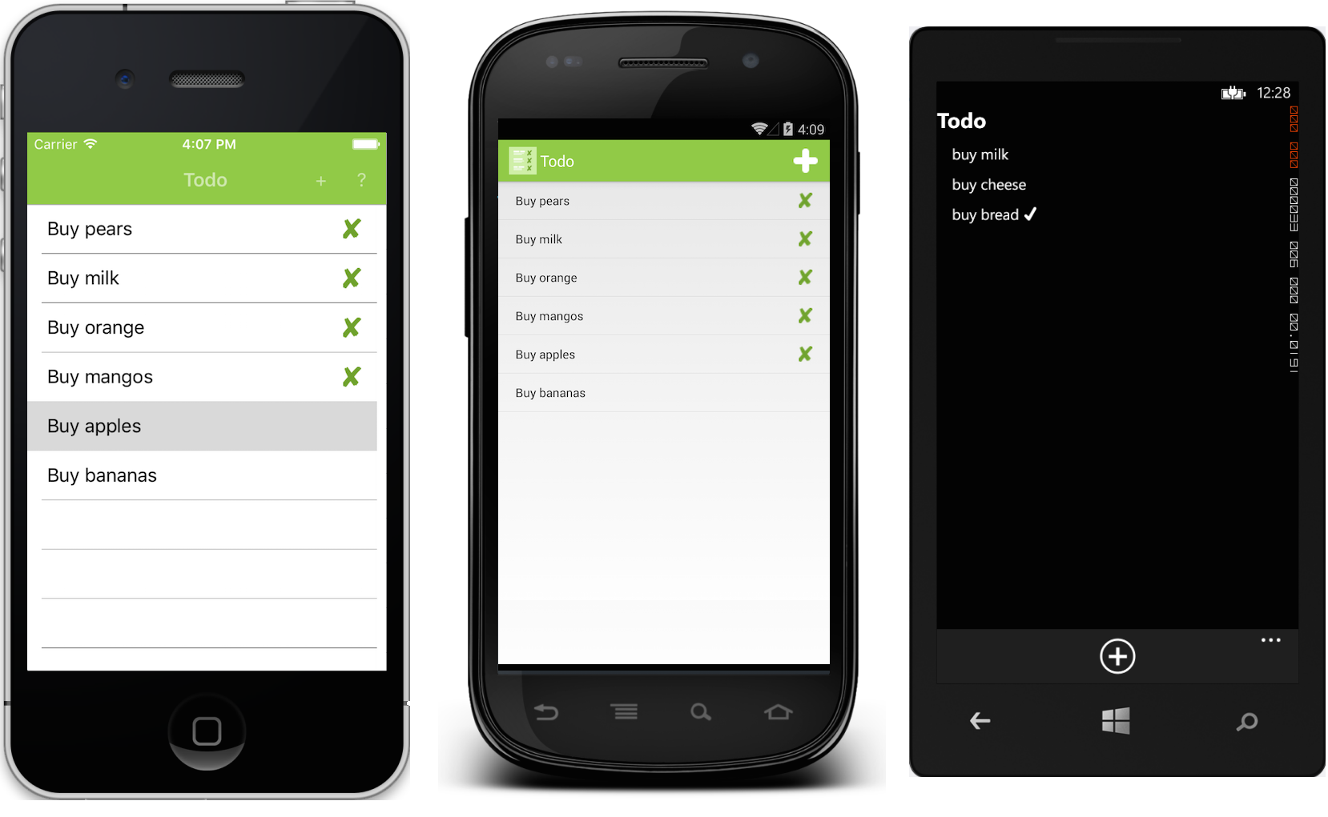
Xamarin Example
https://developer.xamarin.com/samples/xamarin-forms/Todo/
Notes:
Ios, Android, Windows Phone, these would all be generated from same code
(funny that the sample is a shopping list!)

Slide 13
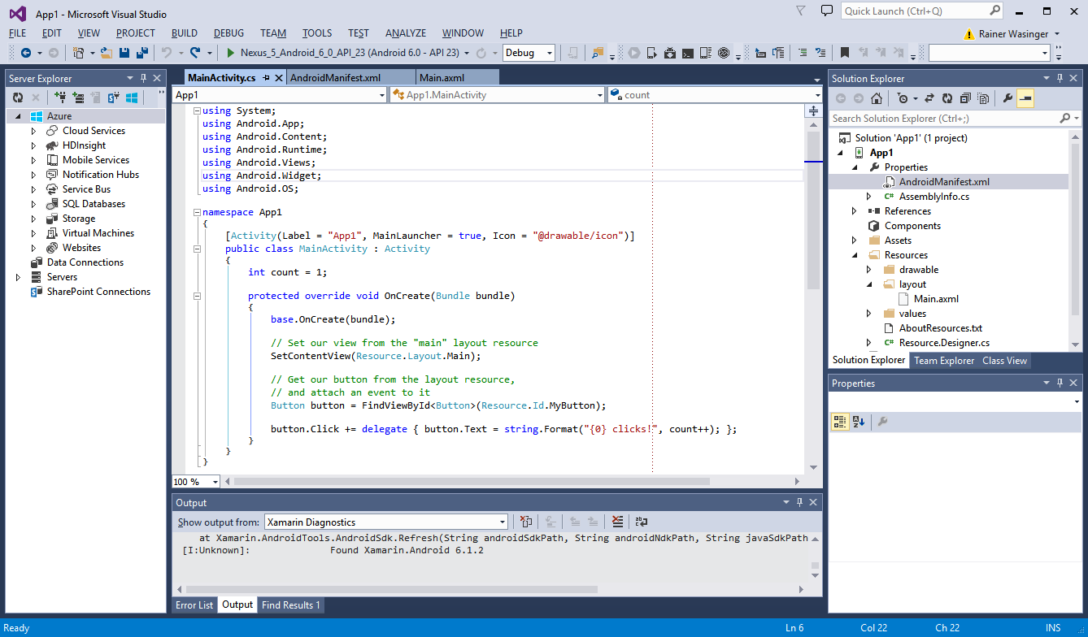
Xamarin Cross-platform Development
Notes:
Note the similarity to Android code here

Slide 14
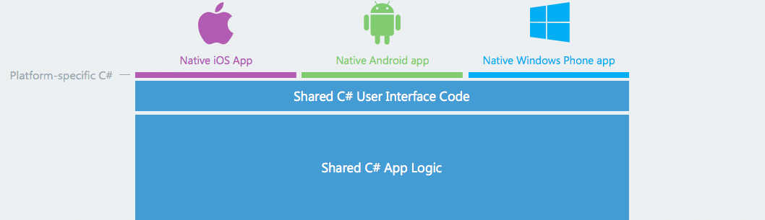
Xamarin Cross-platform Development
https://www.xamarin.com/platform
Notes:
Note that “platform specific C#” is deliberately very small in this diagram from Xamarin
Indicating that you only need to write a small amount of platform specific code

Slide 15
Flutter
Open-source
Engine in C/C++
User code written in Dart
Language originally created by Google
Syntax looks very similar to JavaScript
Object-Oriented, supports interfaces, abstracts, generics
Android and iOS
Compiled down to native code, no interpreter
Doesn’t use native UI components
Has a low-level rendering engine which is capable of mimicking the style of Android and iOS components, but also rendering anything at all
Built-in Material Design (Android) styling+widgets
Built-in Cuppertino (iOS-like) styling+widgets
Notes:
https://flutter.io/faq/#what-technology-is-flutter-built-with

Slide 16
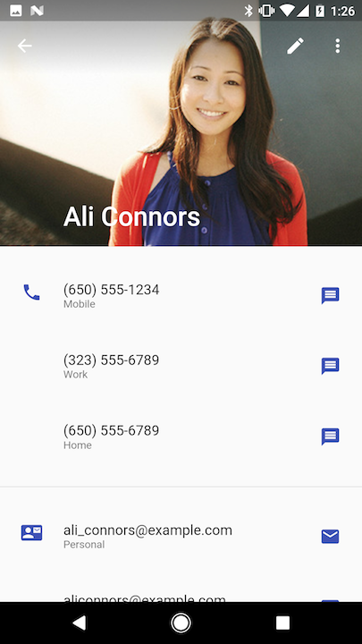
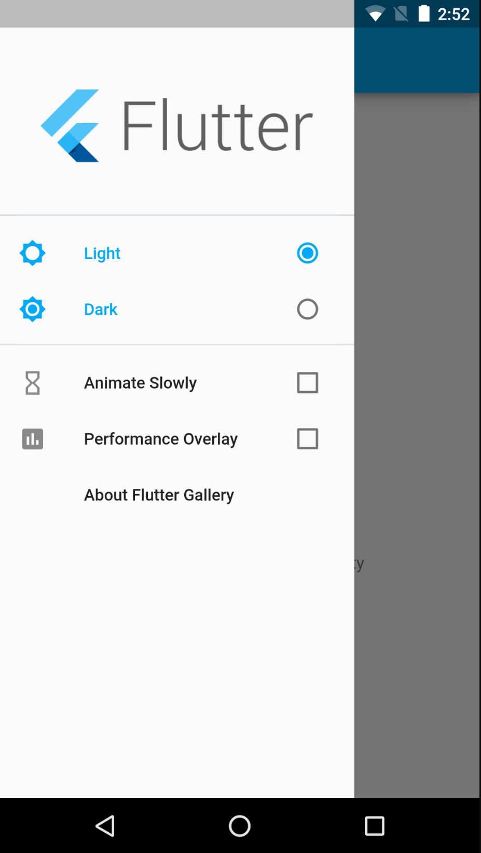
Flutter Examples
Produces high quality, native-looking interfaces
Also capable of creating 2D games
Gallery
https://play.google.com/store/apps/details?id=io.flutter.gallery&hl=en_AU
Notes:
A snazzy marketing video on flutter (watch if you have time) https://www.youtube.com/watch?v=fq4N0hgOWzU

Slide 17
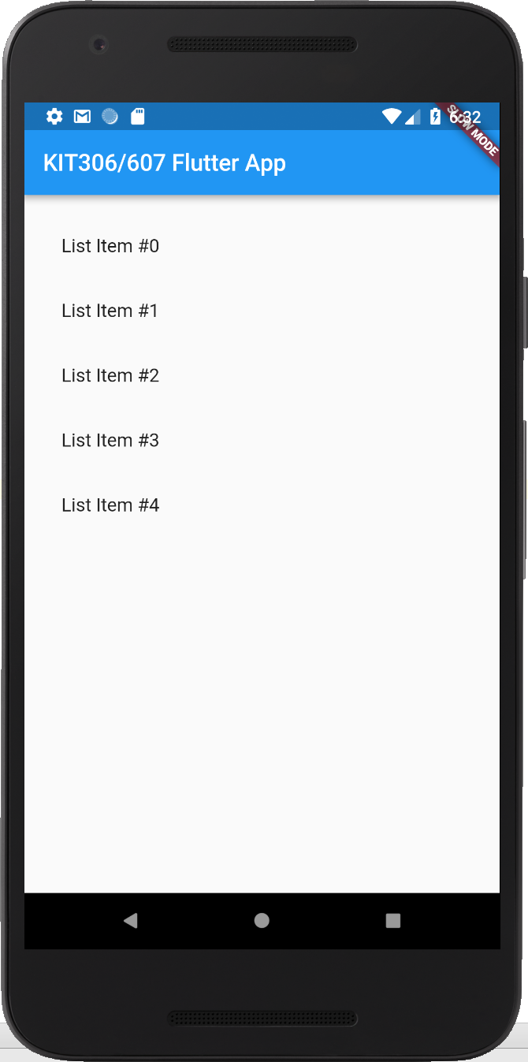
Flutter Code Example
import 'package:flutter/material.dart'; void main() => runApp(new MyApp()); class MyApp extends StatelessWidget { @override Widget build(BuildContext context) { return MaterialApp( home: Scaffold( appBar: AppBar( title: Text('KIT306/607 Flutter App'), ), body: ListView.builder( padding: const EdgeInsets.all(16.0), itemBuilder: (context, i) { return ListTile( title: Text("List Item #"+i.toString()) ); }, itemCount: 5, ) ) ); } }
Notes:
Just a simple example of how we can make an app that looks exactly like our native ones, but with completely different code
Widgets are things like:
MyApp
MaterialApp
Scaffold (this lets us have app bars, tab bars, navigation bars, floating action buttons)
AppBar
ListView (created using a ListView.builder factory pattern, note the itemBuilder inline function)
ListTile (for each row)

Slide 18
Flutter for the Web
https://flutter.dev/web
Same codebase targets Android, iOS, Web
Alpha launched in 2020
Growing functionality + stability
Core problems right now:
Cannot select text - FIXED
No “hover pointer” above links - FIXED
Easy to add this in yourself
Navigation via URL + url parameters is a bit awkward
Difficult to embed HTML components
Difficult to embed inside a full HTML page
Loading times
Support for existing dart plugins limited

Slide 19
A Deeper Look at Flutter

Slide 20
Installing Flutter
Easiest way to use Flutter is through Android Studio
Although I personally use it in VSCode
Install Flutter Plugin for Android Studio, and when creating a new Flutter application, there is a link to install the SDK
It is quite a big download with a LOT of files
That is why I want you to download the SDK before your tutorial
Getting started guide
See Self Study on MyLO (you should have this done before this week’s tutorial)
https://flutter.dev/docs/get-started/
I also like to do a lot of testing in the web browser and then later on a real device
Because we all know how much Android Emulator sucks
But if on a mac, the iphone Simulator isn’t too bad

Slide 21
Dart 101
Flutter is programmed in Dart
Developed by Google in 2011
Compiles down to the native machine code of target platform
E.g. ARM or x64
When targeting Web, compiles down to native JavaScript
Uses Just In Time compiling during development for Hot Reload and debugging support
Uses Ahead of Time compiling for production code for consistent, fast start-up times
Designed for Declarative UI
Similar syntax to Kotlin and Swift
Object-Oriented, Type-safe
Null Safety using Nullables (since 2018, https://dart.dev/null-safety)
Full support for async/await operations

Slide 22
Dart 101
See Official Documentation
A basic introduction (doesn’t really cover data types)
https://dart.dev/samples
We will explore this in the lecture, rather than having slides for this
We will also look at a sample Flutter app in a few slides time
A complete language tour (too long to read in one go, an excellent reference though, and covers data types)
https://dart.dev/guides/language/language-tour
A tour of common library functions (again a good reference)
https://dart.dev/guides/libraries/library-tour
Sick of Android Studio? Explore the language here
https://dartpad.dev/ (Choose samples in top right)

Slide 23
Dart 101
https://dart.dev/samples

Slide 24
Flutter 101
See Official Documentation
The “Cookbook” is great, as it shows lots of samples for common tasks
https://flutter.dev/docs/cookbook
Widget of the week is awesome
https://www.youtube.com/playlist?list=PLjxrf2q8roU23XGwz3Km7sQZFTdB996iG

Slide 25
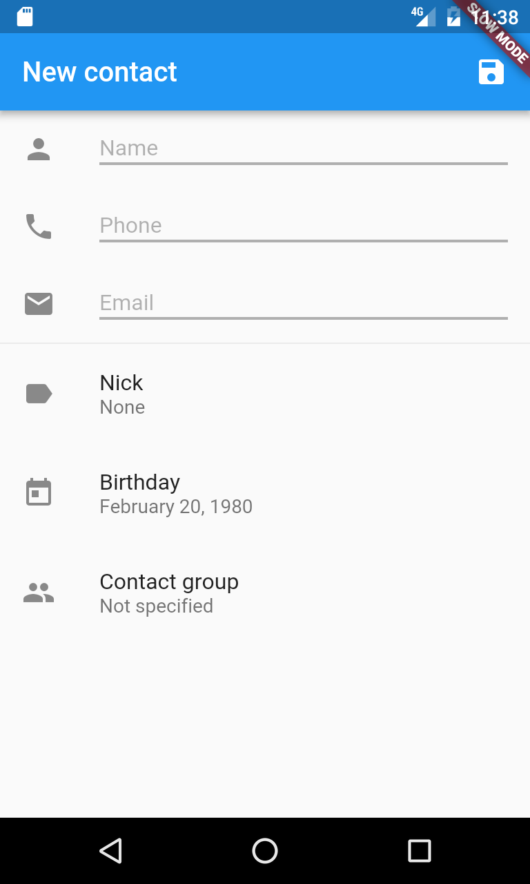
Widgets
Building blocks of your app
Can represent lots of things
“atomic” items like Text, TextField, RaisedButton, Image
“layout” items like Column, Row, Center, Scaffold
“builder” items like ListView, FutureBuilder
“styles” such as TextStyle, InputDecorator (passed in as parameters)
animations
https://flutter.dev/docs/development/ui/widgets
https://flutter.github.io/gallery/#/
Everything you do in Flutter is about:
working out the right widget for the job (create your own, or built in?
what parameters you need to use
how to pass data around and manage state (hard, covered later and in tutorials)

Slide 26
Declarative UI – A Change in Thinking
Modern approach to building UIs
As opposed to imperative programming
Used by frameworks like React, SwiftUI and even HTML
Tell your program what the result should be, not necessarily how to achieve it
i.e. in Flutter we specify a Widget Tree, and the engine handles the rest (e.g. when to build/rebuild, transitions between screens etc)
Often combined with the concept of State Management
i.e. where to store values that change over time
Getting this wrong/right can have a big impact on performance
Thinking about state management will likely be a massive shift in how you think about programming UI

Slide 27
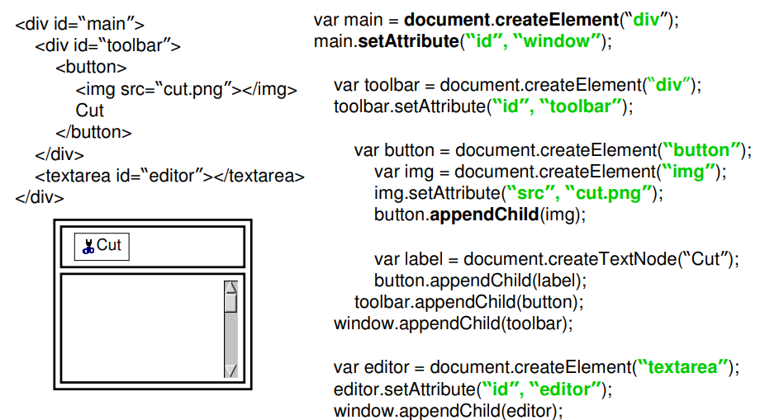
Declarative UI – A Change in Thinking
Example: HTML vs JavaScript DOM Manipulation
http://courses.csail.mit.edu/6.831/archive/2006/lectures/L9.pdf

Slide 28
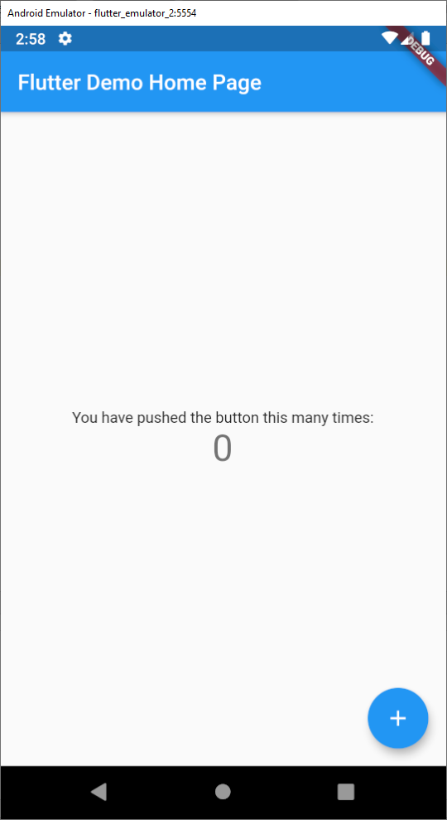
The Sample Flutter App
import 'package:flutter/material.dart'; void main() { runApp(MyApp()); } class MyApp extends StatelessWidget { const MyApp({Key? key}) : super(key: key); @override Widget build(BuildContext context) { return MaterialApp( title: 'Flutter Demo', theme: ThemeData( primarySwatch: Colors.blue, ), home: MyHomePage(title: 'Flutter Demo Home Page'), ); } }

Slide 29
The Sample Flutter App
import 'package:flutter/material.dart'; void main() { runApp(MyApp()); } class MyApp extends StatelessWidget { const MyApp({Key? key}) : super(key: key); @override Widget build(BuildContext context) { return MaterialApp( title: 'Flutter Demo', theme: ThemeData( primarySwatch: Colors.blue, ), home: MyHomePage(title: 'Flutter Demo Home Page'), ); } }
Main entry point to app. Magic runApp() function takes a Widget as a parameter
Defining a new custom Widget called MyApp
All widgets have a build() function, returning what it looks like.
MaterialApp is a built-in widget to give us Android styling.
title, theme, and home are parameters to the MaterialApp widget (there are more)
MyHomePage is a custom widget, next slide

Slide 30
Parameters and State
Parameters
Information “passed down” to a widget
E.g. the title of the AppBar
E.g. the initial value of a TextField
Are not changed within a widget
State
Current information about a widget that the widget may change about itself
E.g.
Number of times the button has been clicked
The current value of the text field
The index of the currently selected product
The current frame of an animation
For performance, widgets are only re-rendered when their state changes
So we use a StatefulWidget + State Object combo pattern
Complex at first, with boilerplate code, but once you get used to it, its fine
Change state variables with call to setState()

Slide 31
A Stateful Widget
Defining a new custom Widget MyHomePage
class MyHomePage extends StatefulWidget { MyHomePage({Key? key, required this.title}) : super(key: key); final String title; @override _MyHomePageState createState() => _MyHomePageState(); } class _MyHomePageState extends State<MyHomePage> { int _counter = 0; void _incrementCounter() { setState(() { _counter++; }); } ...
A single parameter title, passed in. Recall:
MyHomePage(title: 'Flutter Demo Home Page'),
Stateful Widgets have a State object, for storing state, and displaying widget
A state variable for this widget, storing how many times the button has been clicked.
Whenever we modify the state, it HAS to be done inside the callback to a setState function.

Slide 32
Common UI Widgets
class _MyHomePageState extends State<MyHomePage> { ... @override Widget build(BuildContext context) { return Scaffold( appBar: AppBar( title: Text(widget.title), ), body: Center( child: Column( mainAxisAlignment: MainAxisAlignment.center, children: <Widget>[ Text( 'You have pushed the button this many times:', ), Text( '$_counter', style: Theme.of(context).textTheme.headline4, ), ], ), ), floatingActionButton: FloatingActionButton( onPressed: _incrementCounter, tooltip: 'Increment', child: Icon(Icons.add), ), ); } }

Slide 33
Common UI Widgets
class _MyHomePageState extends State<MyHomePage> { ... @override Widget build(BuildContext context) { return Scaffold( appBar: AppBar( title: Text(widget.title), ), body: Center( child: Column( mainAxisAlignment: MainAxisAlignment.center, children: <Widget>[ Text( 'You have pushed the button this many times:', ), Text( '$_counter', style: Theme.of(context).textTheme.headline4, ), ], ), ), floatingActionButton: FloatingActionButton( onPressed: _incrementCounter, tooltip: 'Increment', child: Icon(Icons.add), ), ); } }

Slide 34
Common UI Widgets
class _MyHomePageState extends State<MyHomePage> { ... @override Widget build(BuildContext context) { return Scaffold( appBar: AppBar( title: Text(widget.title), ), body: Center( child: Column( mainAxisAlignment: MainAxisAlignment.center, children: <Widget>[ Text( 'You have pushed the button this many times:', ), Text( '$_counter', style: Theme.of(context).textTheme.headline4, ), ], ), ), floatingActionButton: FloatingActionButton( onPressed: _incrementCounter, tooltip: 'Increment', child: Icon(Icons.add), ), ); } }

Slide 35
Common UI Widgets
class _MyHomePageState extends State<MyHomePage> { ... @override Widget build(BuildContext context) { return Scaffold( appBar: AppBar( title: Text(widget.title), ), body: Center( child: Column( mainAxisAlignment: MainAxisAlignment.center, children: <Widget>[ Text( 'You have pushed the button this many times:', ), Text( '$_counter', style: Theme.of(context).textTheme.headline4, ), ], ), ), floatingActionButton: FloatingActionButton( onPressed: _incrementCounter, tooltip: 'Increment', child: Icon(Icons.add), ), ); } }

Slide 36
Common UI Widgets
class _MyHomePageState extends State<MyHomePage> { ... @override Widget build(BuildContext context) { return Scaffold( appBar: AppBar( title: Text(widget.title), ), body: Center( child: Column( mainAxisAlignment: MainAxisAlignment.center, children: <Widget>[ Text( 'You have pushed the button this many times:', ), Text( '$_counter', style: Theme.of(context).textTheme.headline4, ), ], ), ), floatingActionButton: FloatingActionButton( onPressed: _incrementCounter, tooltip: 'Increment', child: Icon(Icons.add), ), ); } }

Slide 37
Common UI Widgets
class _MyHomePageState extends State<MyHomePage> { ... @override Widget build(BuildContext context) { return Scaffold( appBar: AppBar( title: Text(widget.title), ), body: Center( child: Column( mainAxisAlignment: MainAxisAlignment.center, children: <Widget>[ Text( 'You have pushed the button this many times:', ), Text( '$_counter', style: Theme.of(context).textTheme.headline4, ), ], ), ), floatingActionButton: FloatingActionButton( onPressed: _incrementCounter, tooltip: 'Increment', child: Icon(Icons.add), ), ); } }

Slide 38
Common UI Widgets
class _MyHomePageState extends State<MyHomePage> { ... @override Widget build(BuildContext context) { return Scaffold( appBar: AppBar( title: Text(widget.title), ), body: Center( child: Column( mainAxisAlignment: MainAxisAlignment.center, children: <Widget>[ Text( 'You have pushed the button this many times:', ), Text( '$_counter', style: Theme.of(context).textTheme.headline4, ), ], ), ), floatingActionButton: FloatingActionButton( onPressed: _incrementCounter, tooltip: 'Increment', child: Icon(Icons.add), ), ); } }

Slide 39
Common UI Widgets
class _MyHomePageState extends State<MyHomePage> { ... @override Widget build(BuildContext context) { return Scaffold( appBar: AppBar( title: Text(widget.title), ), body: Center( child: Column( mainAxisAlignment: MainAxisAlignment.center, children: <Widget>[ Text( 'You have pushed the button this many times:', ), Text( '$_counter', style: Theme.of(context).textTheme.headline4, ), ], ), ), floatingActionButton: FloatingActionButton( onPressed: _incrementCounter, tooltip: 'Increment', child: Icon(Icons.add), ), ); } }

Slide 40
Common UI Widgets
class _MyHomePageState extends State<MyHomePage> { ... @override Widget build(BuildContext context) { return Scaffold( appBar: AppBar( title: Text(widget.title), ), body: Center( child: Column( mainAxisAlignment: MainAxisAlignment.center, children: <Widget>[ Text( 'You have pushed the button this many times:', ), Text( '$_counter', style: Theme.of(context).textTheme.headline4, ), ], ), ), floatingActionButton: FloatingActionButton( onPressed: _incrementCounter, tooltip: 'Increment', child: Icon(Icons.add), ), ); } }

Slide 41
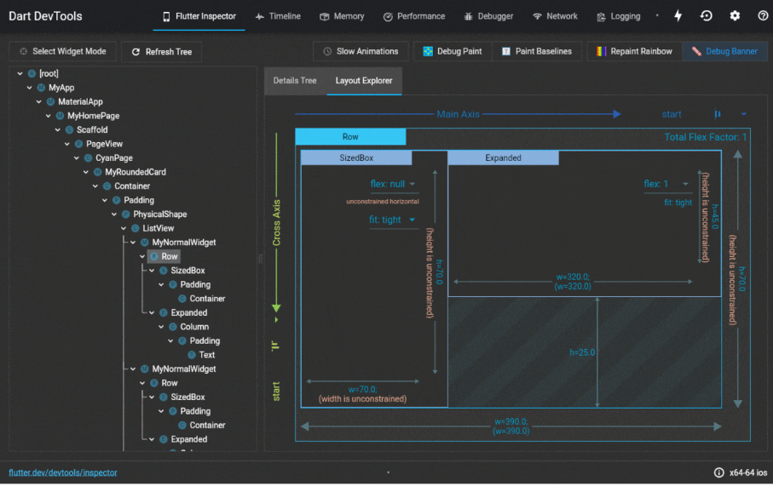
Aside – Flutter Dev Tools
You can inspect your app LIVE using Flutter Dev tools
See the widget hierarchy, inspect parameters and state
Kind of like Chrome Dev tools
https://docs.flutter.dev/development/tools/devtools/overview

Slide 42
Aside – const keyword
class _MyHomePageState extends State<MyHomePage> { ... @override Widget build(BuildContext context) { return Scaffold( appBar: AppBar( title: Text(widget.title), ), body: Center( child: Column( mainAxisAlignment: MainAxisAlignment.center, children: <Widget>[ const Text( 'You have pushed the button this many times:', ), Text( '$_counter', style: Theme.of(context).textTheme.headline4, ), ], ), ), floatingActionButton: FloatingActionButton( onPressed: _incrementCounter, tooltip: 'Increment', child: const Icon(Icons.add), ), ); } }
In later versions of Flutter/Dart, the IDE will complain at you until you use const for things that it has determined will not change
Can be “smart” and determine children widgets are const too
This helps make the code more performant
Alt+Enter will automatically help add these
Some gotchas
Confusing error message when adding a non-const value to something you previous made const

Slide 43
Common Widgets - Scaffold
AppBar
Used to structure an Android page, and is usually the root element each page
Params:
appBar – see next slide
body – the widget that takes up the main portion of screen
floatingActionButton – appears in bottom right corner (is usually a FloatingActionButton widget, but doesn’t have to be)
drawer, endDrawer – menu panes that swipe in from left and right
bottomSheet, bottomNavigationBar
Can be accessed by any child widgets most commonly to show a Snackbar
ScaffoldMessenger.of(context).showSnackBar( SnackBar(content: Text('Yay! A SnackBar!’)) );
https://flutter.dev/docs/cookbook/design/snackbars
Body
FAB
https://www.geeksforgeeks.org/scaffold-class-in-flutter-with-examples/

Slide 44
Common Widgets - AppBar
Used within Scaffolds
Automatically styled with primary colour of app theme
Params
title
Note: this is of type Widget, not String, for flexibility (maybe want to draw a picture here, or use a FutureBuilder etc.)
leading – the widget to appear to left of title
actions – an array of widgets which appear in the app bar (usually buttons)

Slide 45

Common Widgets - Text
Non-editable label
You will learn about editable text in the tutorials (using TextFormField)
Automatically styled based upon the context they are in
E.g. when shown inside title of AppBar, will be white (“on-primary”) and large
Can have style overridden using style parameter
const Text('Cookie is a good girl'), const Text('Cookie is a good girl', style: TextStyle( color:Colors.amber, fontWeight: FontWeight.bold, fontSize: 64, )), Text('Cookie is a good girl', style: TextStyle( color:Theme.of(context).errorColor )),
Notes:
Note the final text in the sample CANNOT have a const, as Theme.of(context) is not a const value

Slide 46
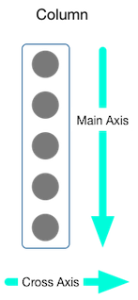
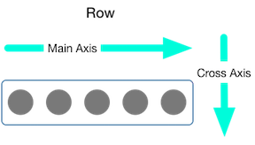
Common Widgets - Column
Column
Layout style widget, like a Vertical LinearLayout, but more flexible
Has Horizontal counterpart, Row
Params
children: list of widgets to be displayed
crossAxisAlignment, mainAxisAlignment: how to lay out children
start, end, center, spaceBetween, spaceAround, spaceEvenly
mainAxisSize: how much space to take up
min, max
Overly-complicated documentation:
https://flutter.dev/docs/development/ui/layout#lay-out-multiple-widgets-vertically-and-horizontally
Row
https://www.geeksforgeeks.org/row-and-column-widgets-in-flutter-with-example/

Slide 47
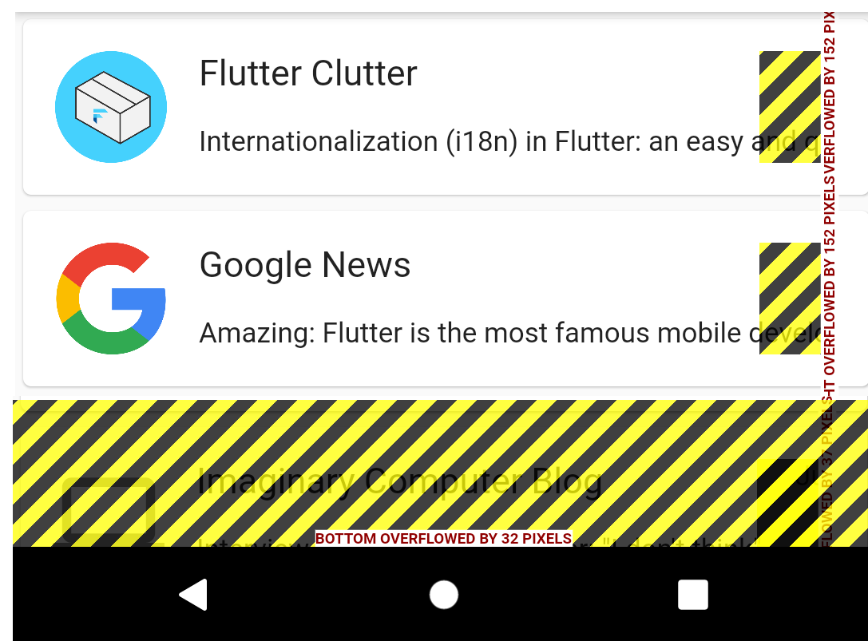

Spoiler Alert
One of the main headaches you will come across in Flutter development is invalid layouts or layouts that overflow
These happen when you accidentally don’t provide enough information about how a widget should be laid out
E.g. unconstrained width or height
The error messages are often confusingly worded, and difficult to trace (due to long stacks)
Here are some common errors, and ways to get around them:
https://flutter.dev/docs/testing/common-errors
A common widget that you may need to solve these errors is the Expanded widget
These widgets can also be the cause of this problem, lol

Slide 48


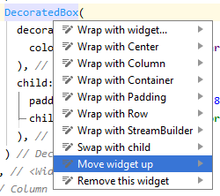
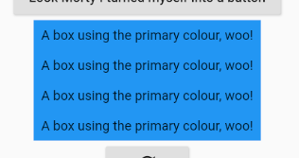
Nice Flutter Features
Hot Reload
Reloads your application after you make code changes
Retains State
Allows you to iterate quickly and see immediate changes without re-navigating
Moving Widgets
Alt+Enter
Extracting/Reusing Custom Widgets
Alt+Enter
ColourfulBox(), ColourfulBox(), ColourfulBox(), ColourfulBox(),
Notes:
We will cover exactly how to do this in the tutorials – if we’re going amazing for time we will get a live demo of this in the lecture

Slide 49
Self Study
Before Week 10 Tutorial
Install Flutter SDK
For some of you, that also means install Android Studio!
Or VSCode, it is up to you

